Slide 1


Slide 2

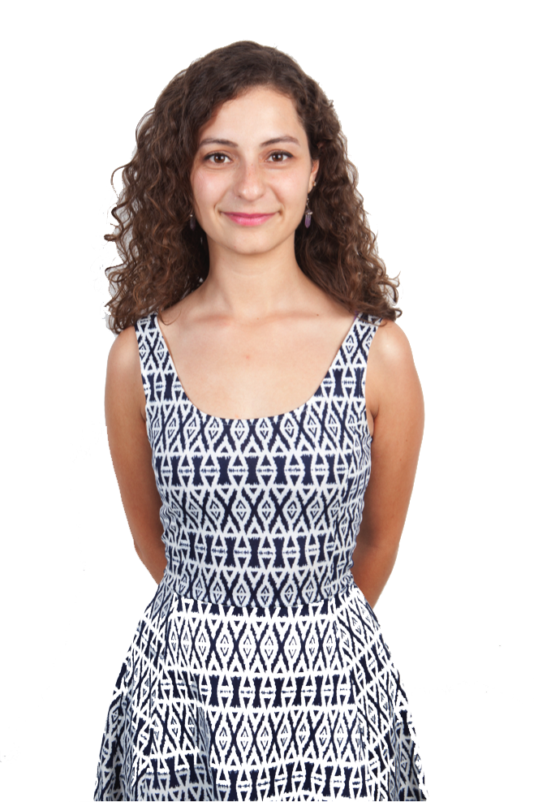

Slide 3
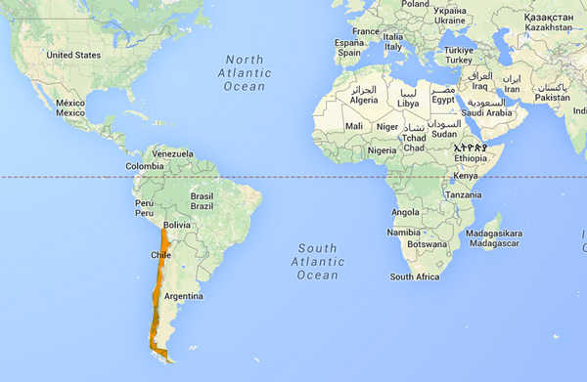

Slide 4
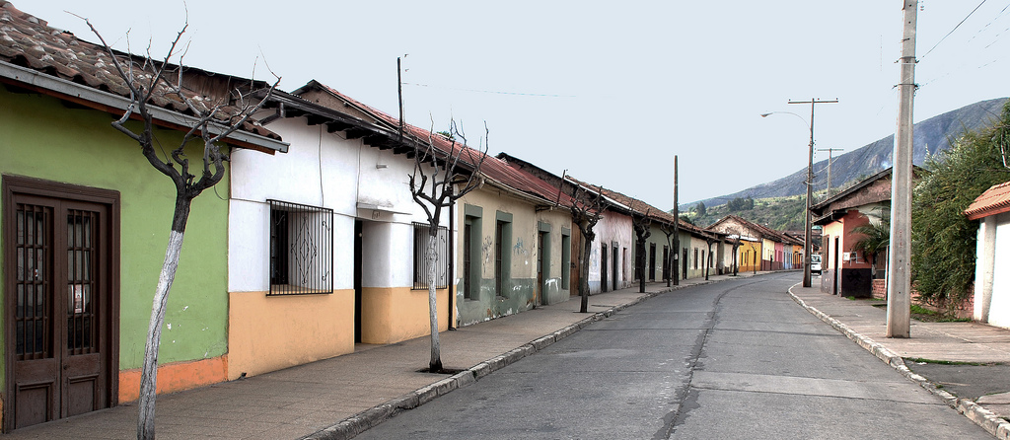

Slide 5
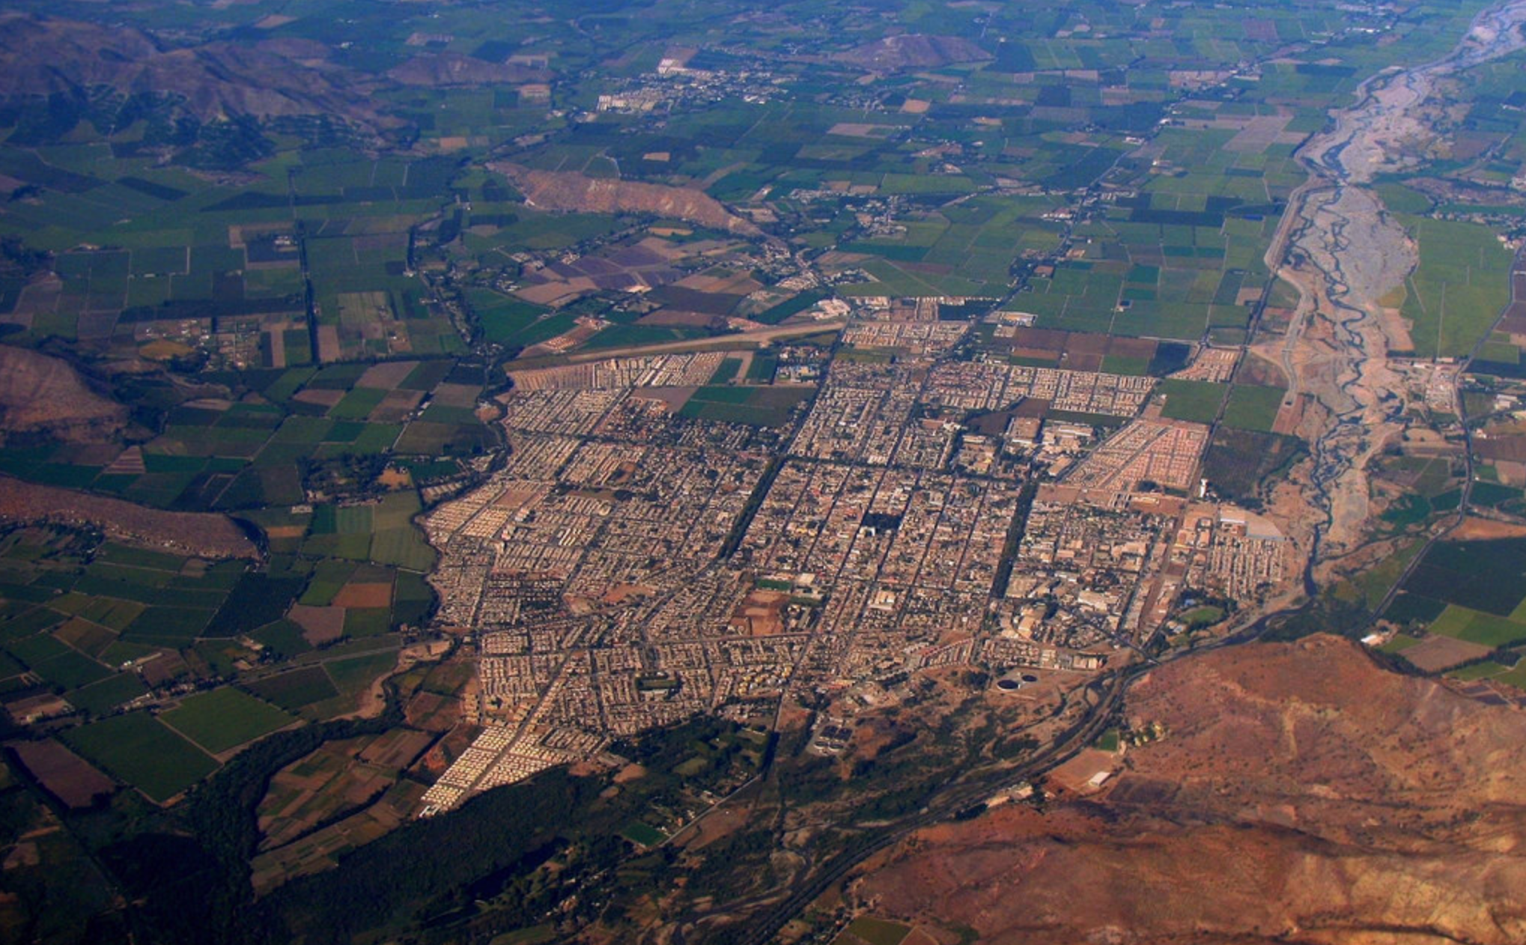

Slide 6
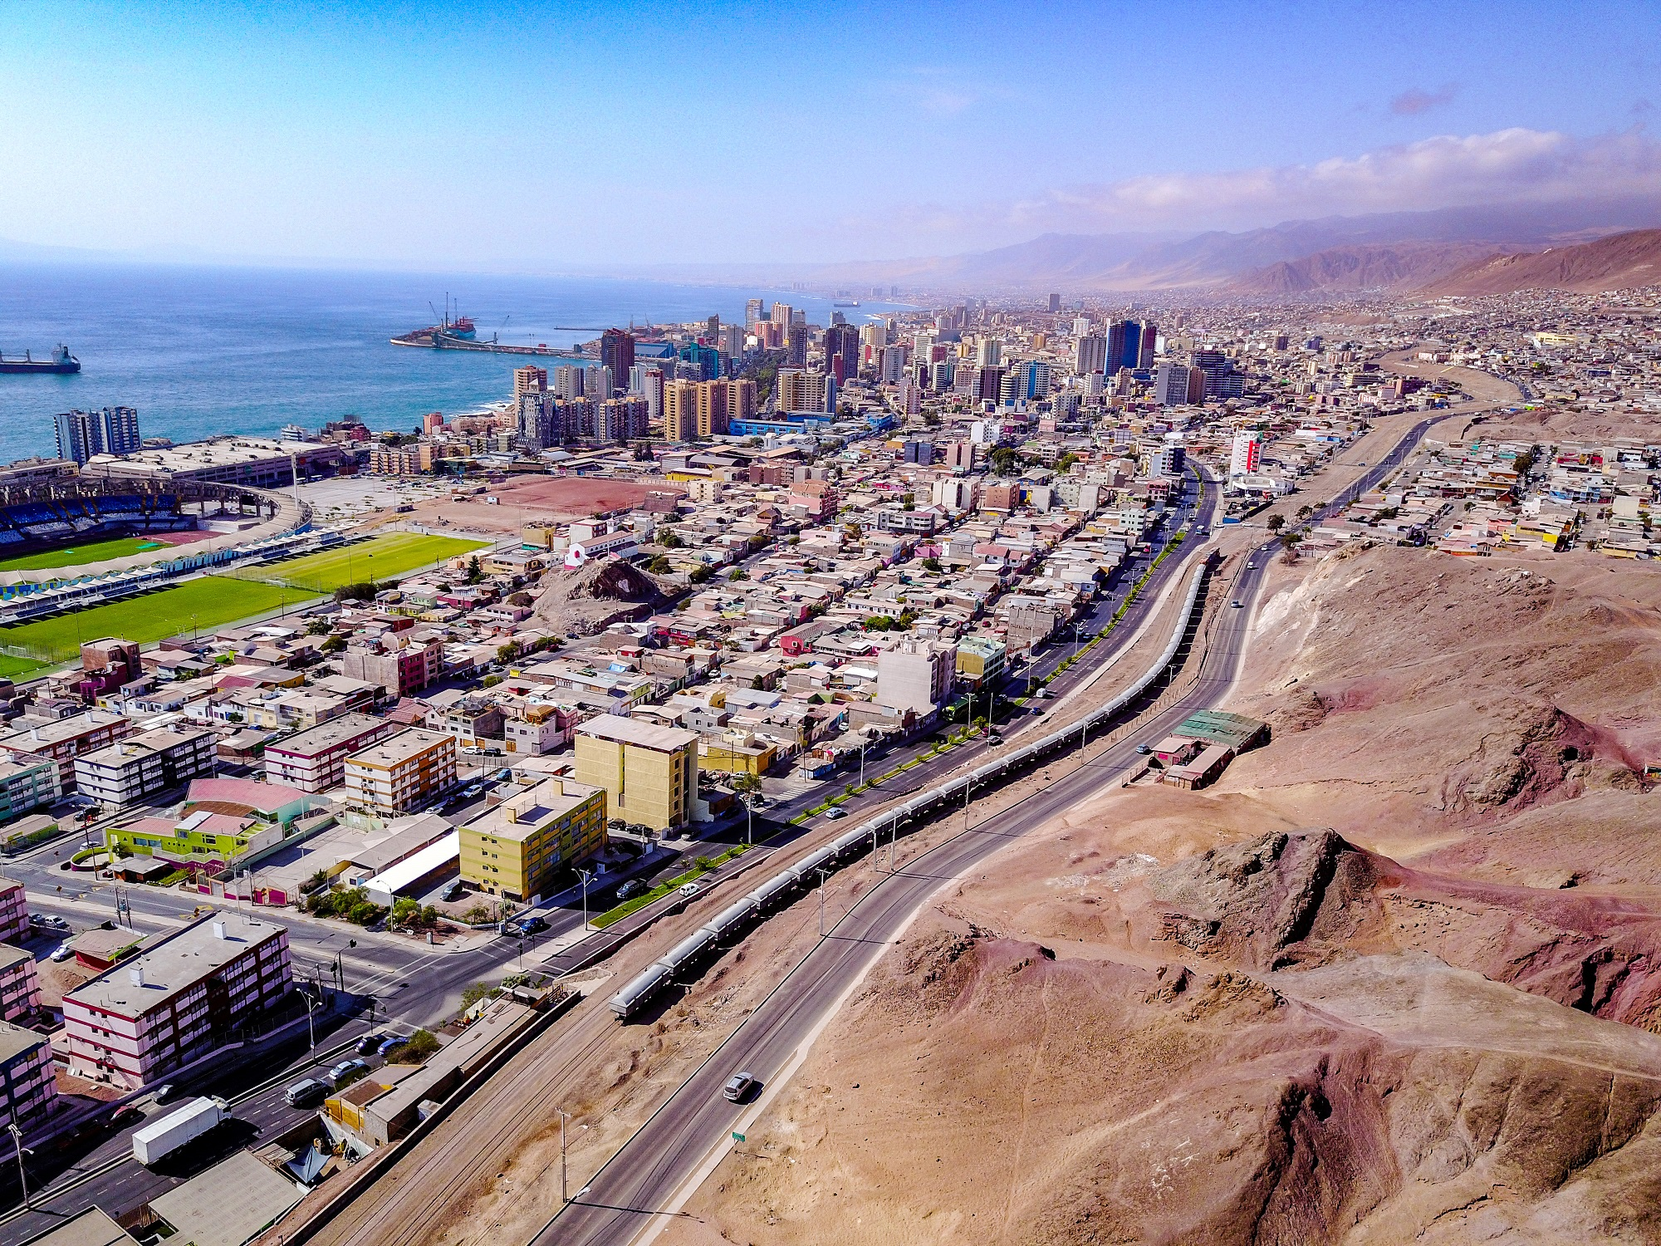

Slide 7
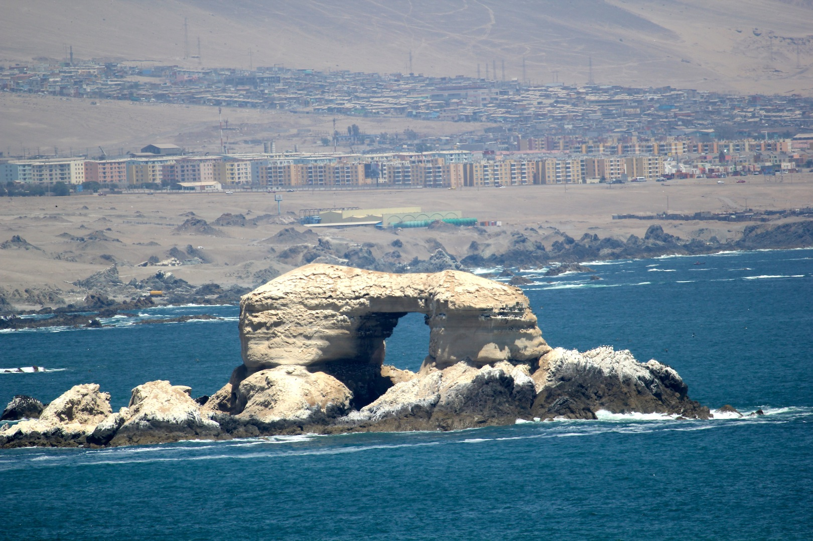

Slide 8
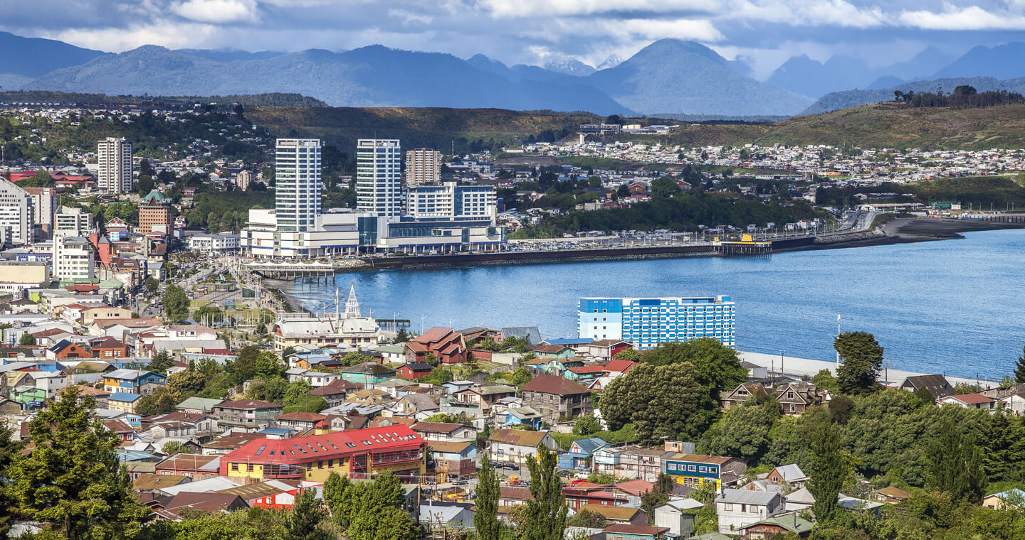

Slide 9
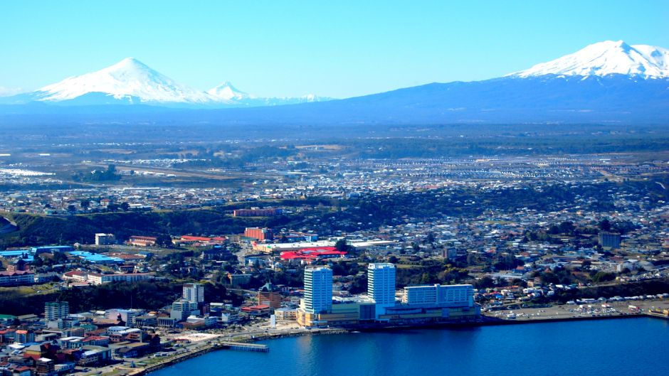

Slide 10
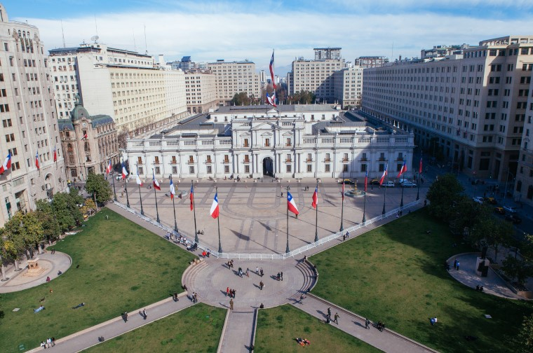

Slide 11
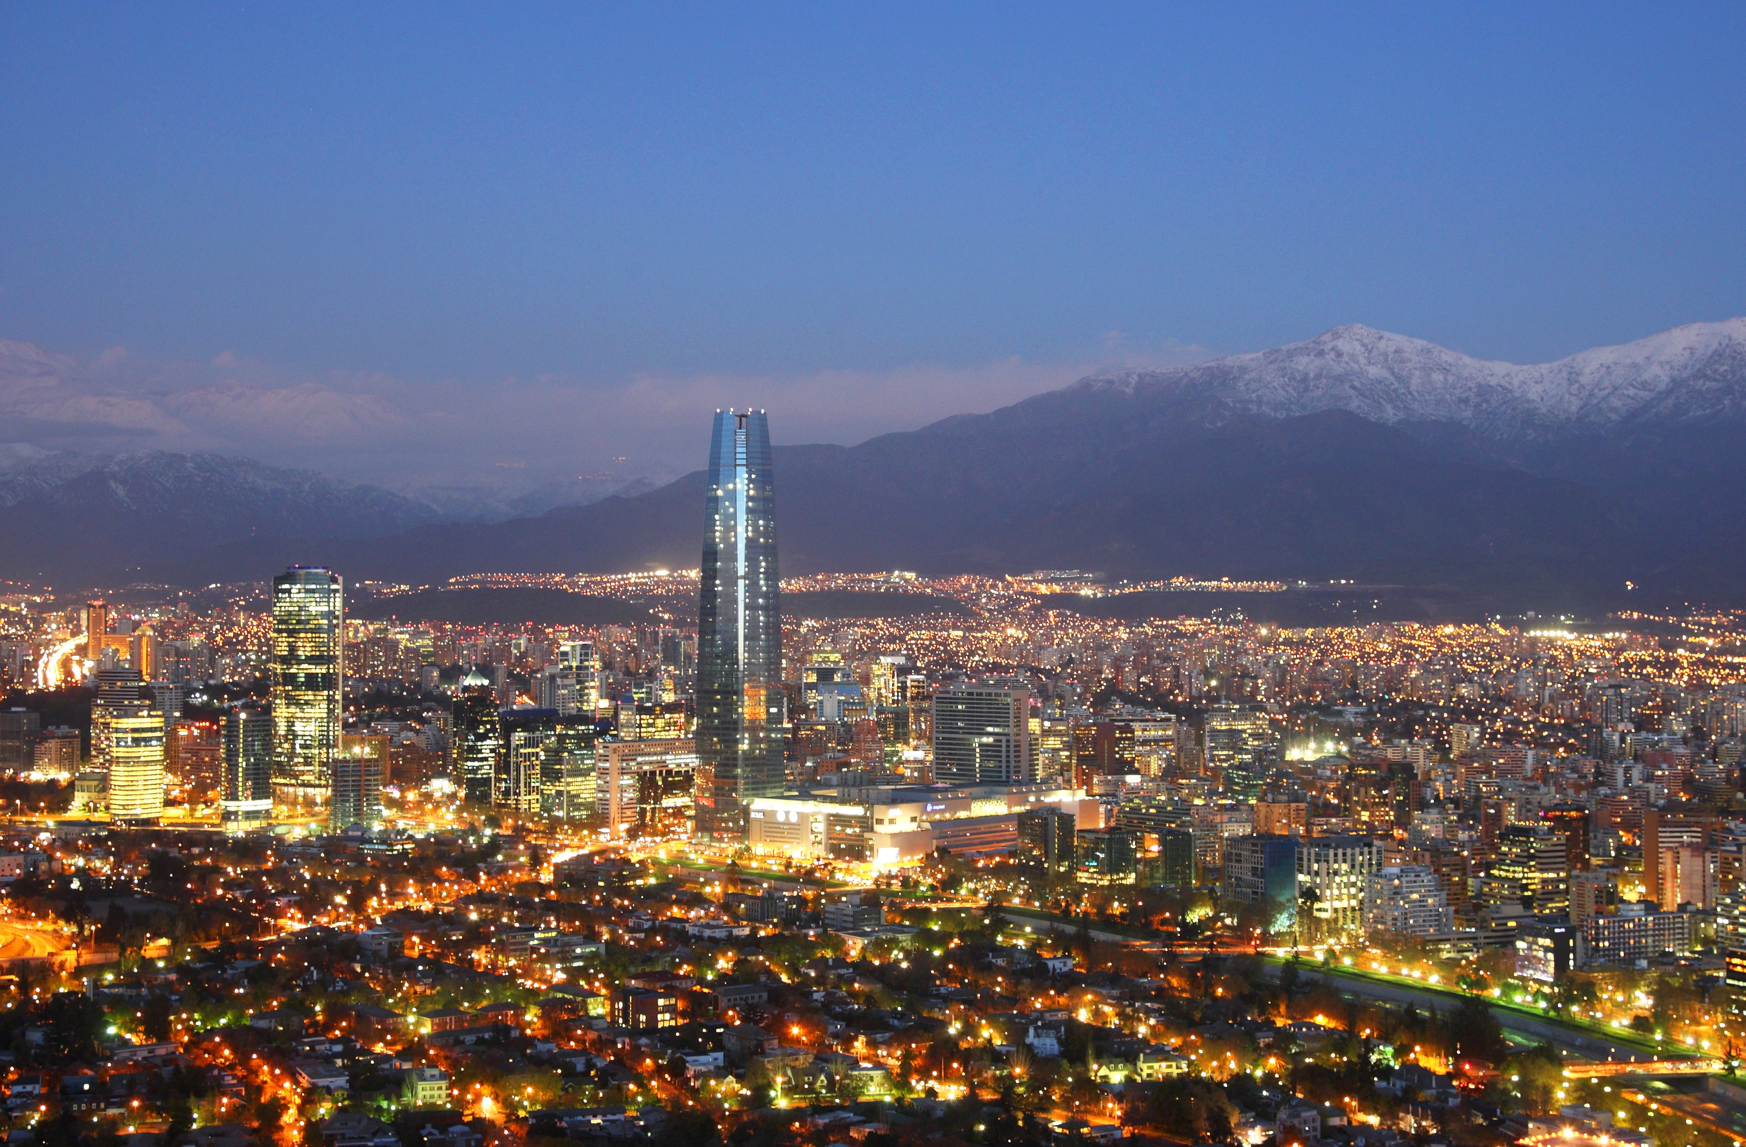

Slide 13
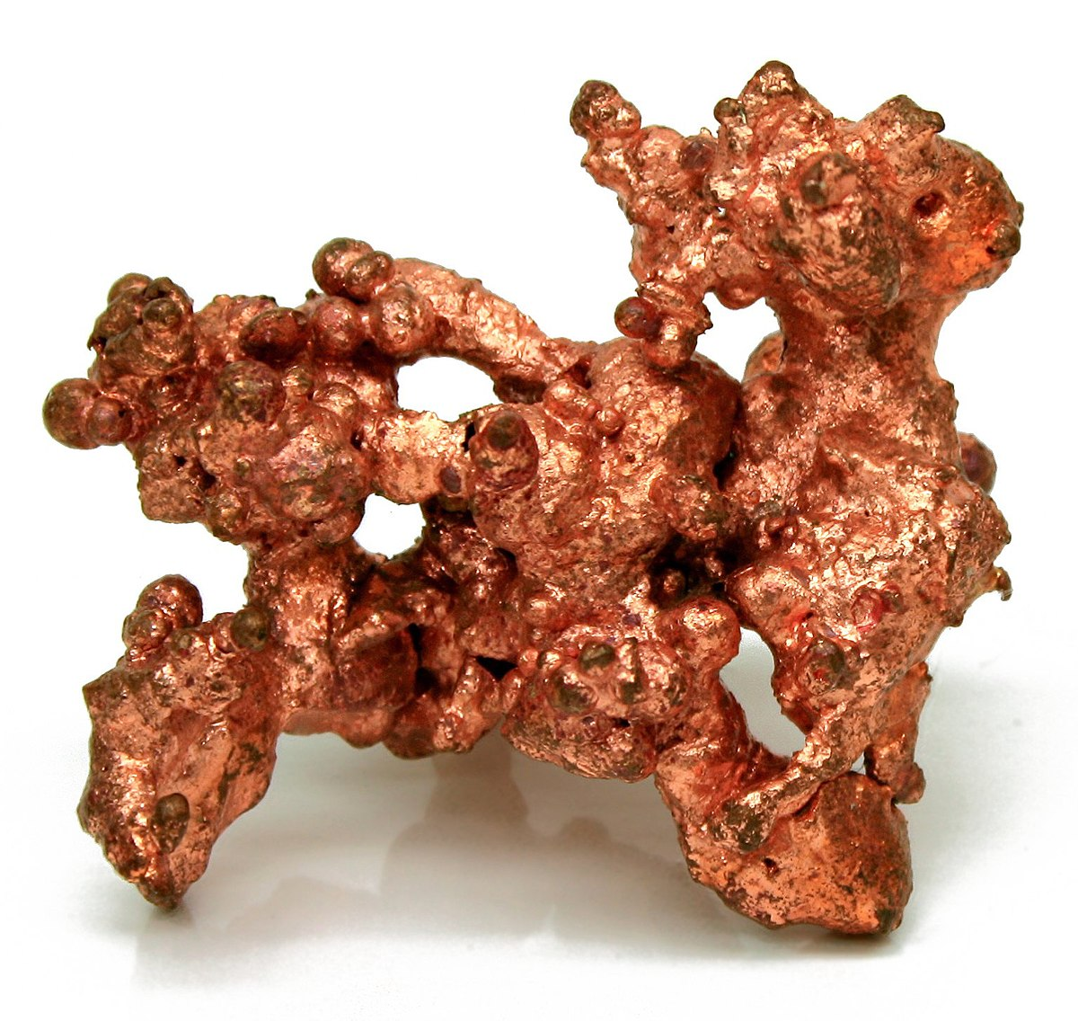
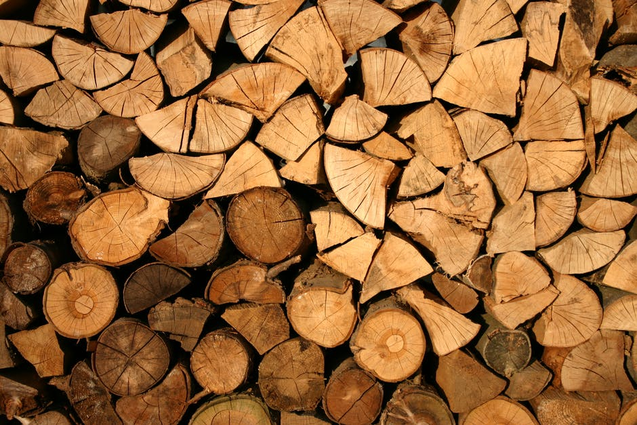

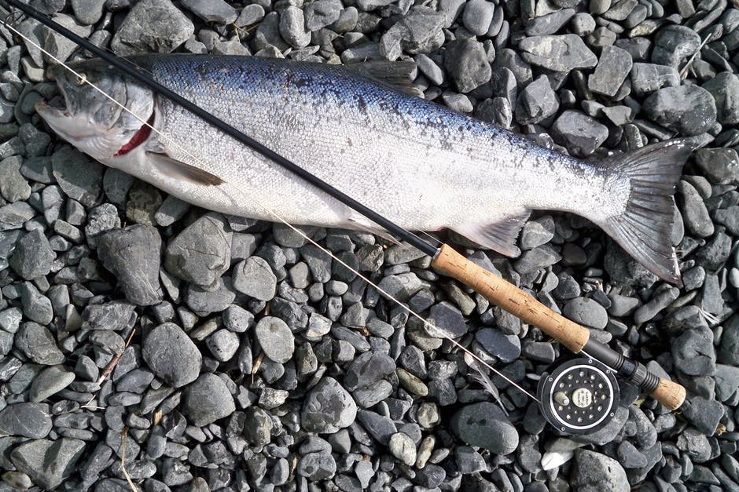

Slide 14
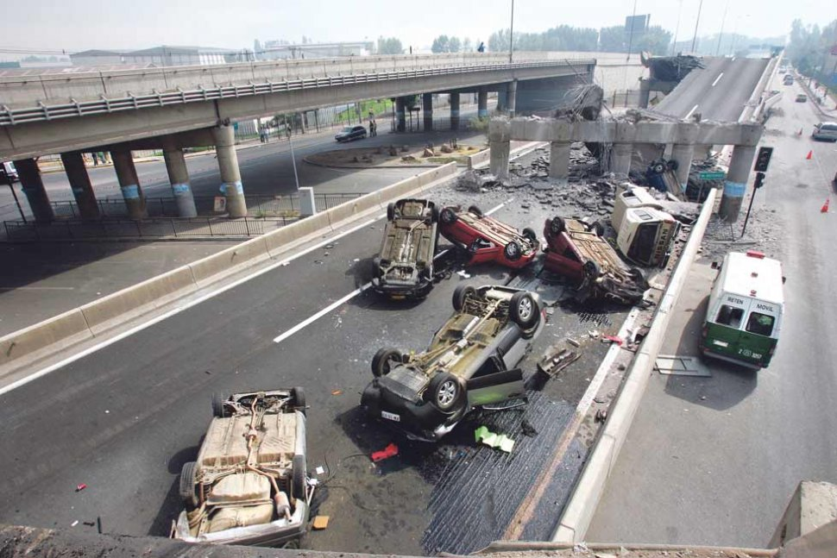

Slide 15
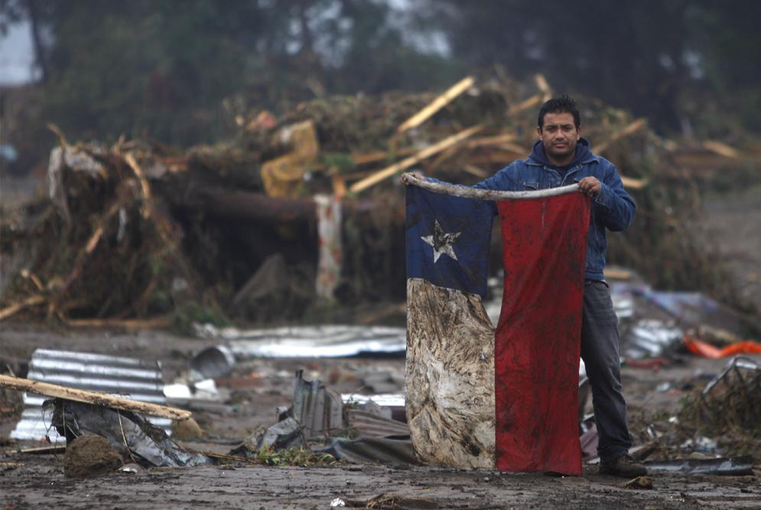
8.8 on the Richter Scale

Slide 16
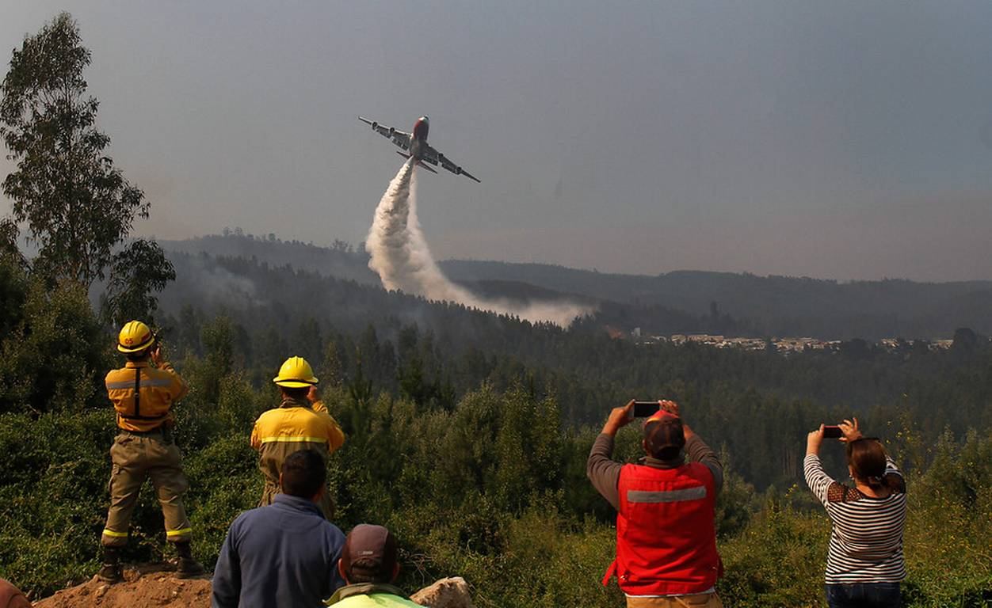

Slide 17
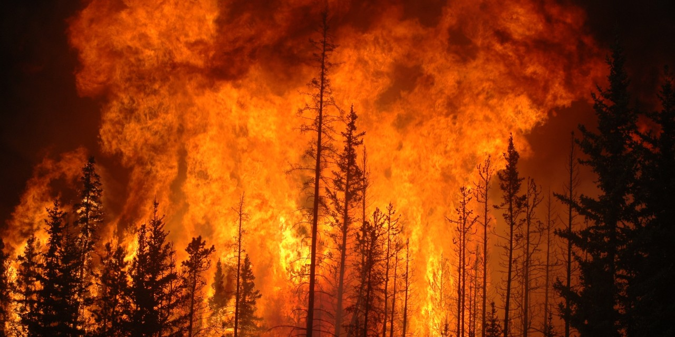
467.000 hectares

Slide 18
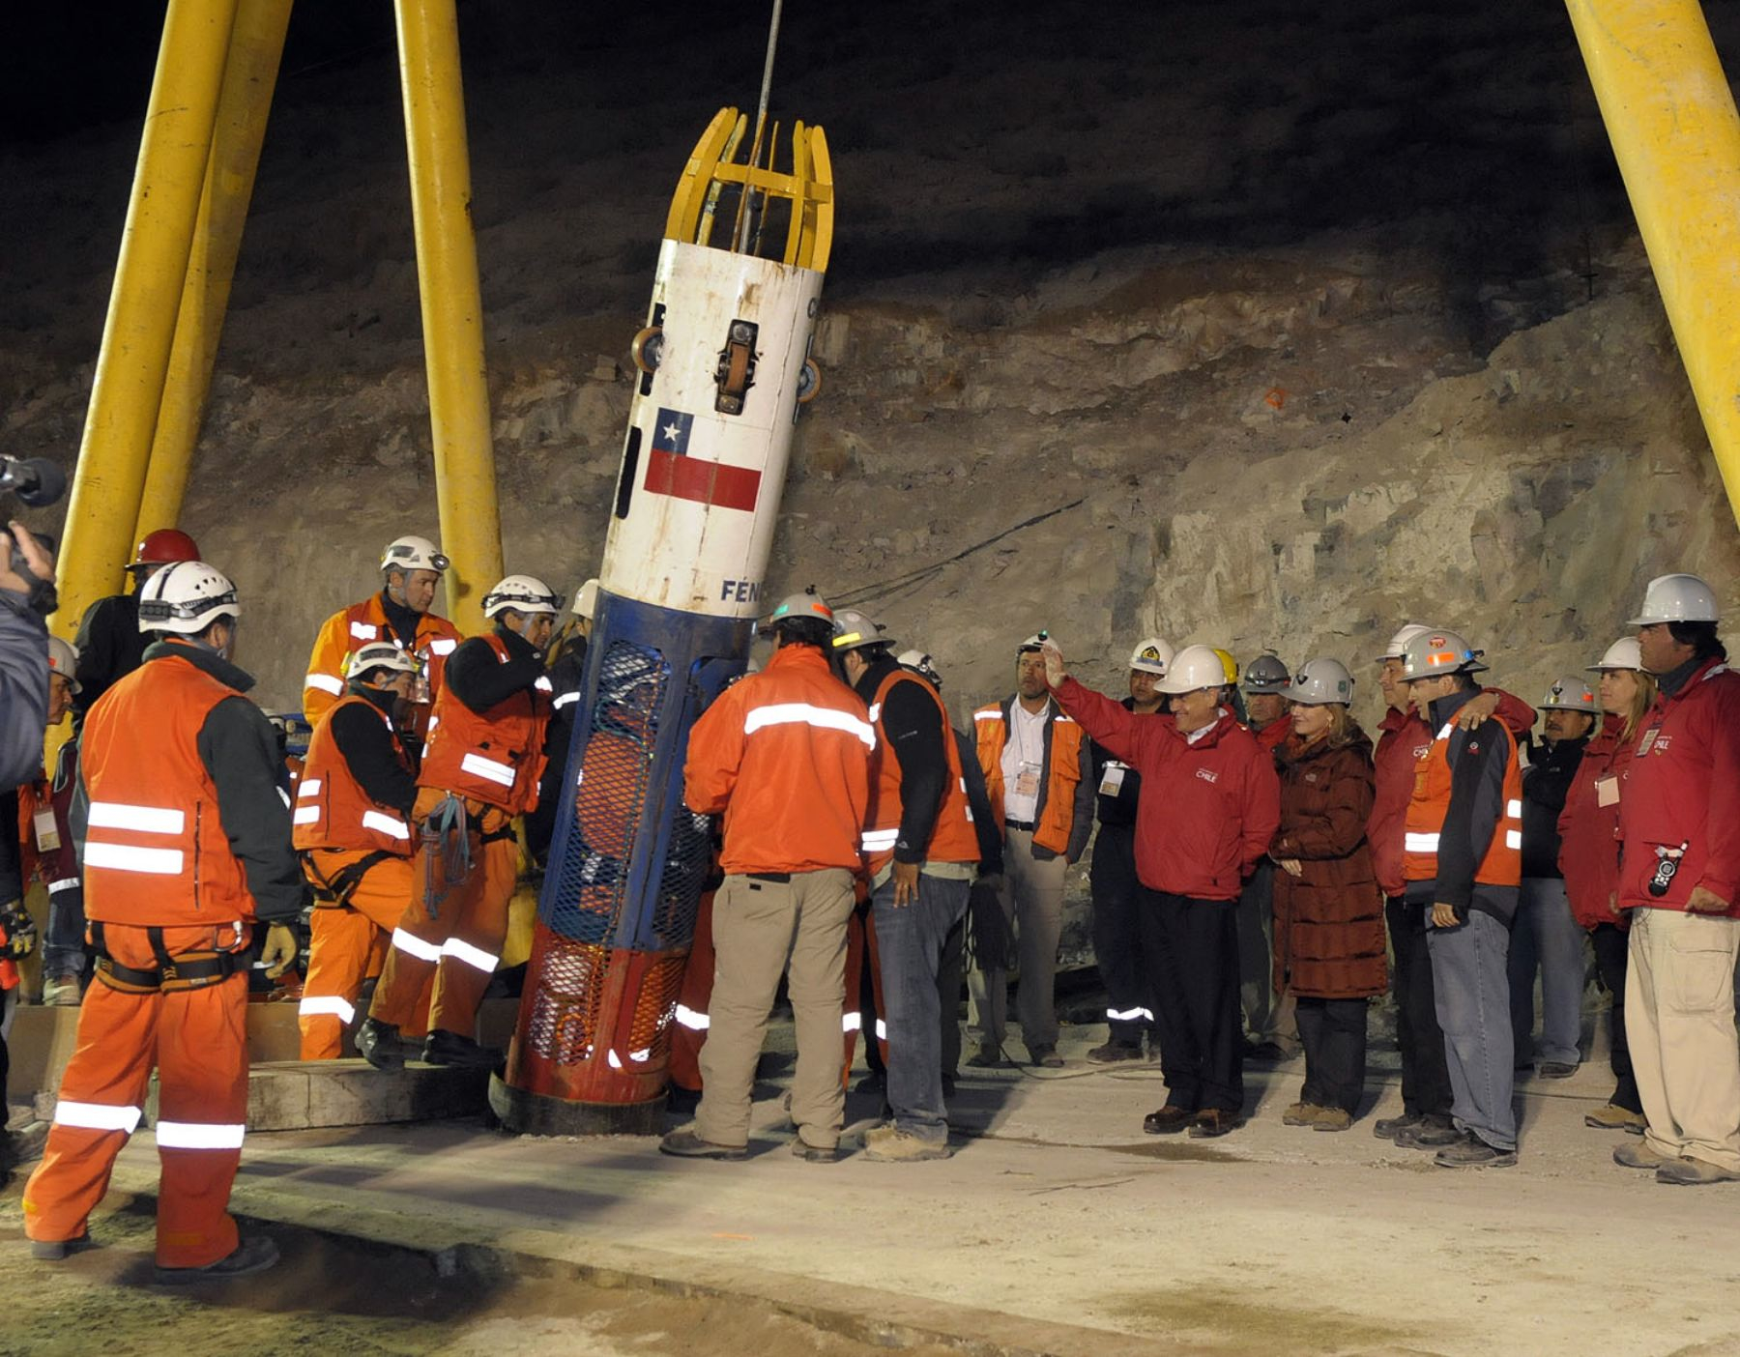

Slide 19
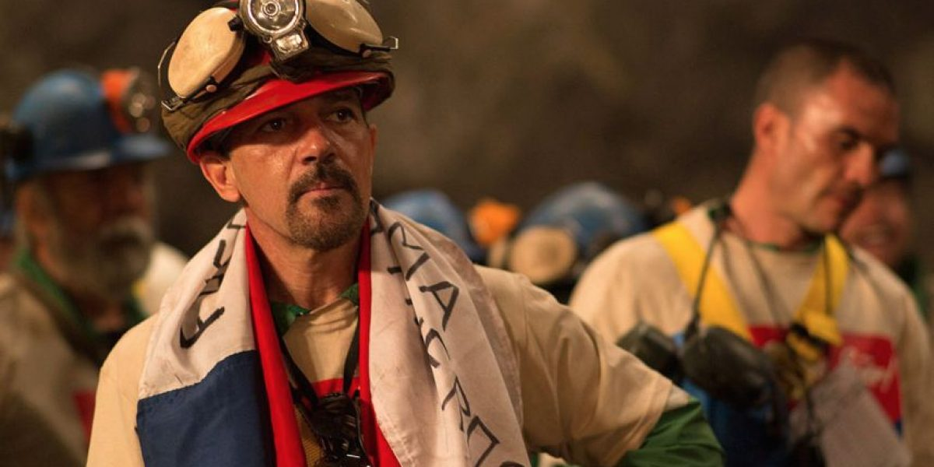

Slide 20
Innovation & Entrepreunership
Sophisticaded Products
¿?
Other disciplines
Creative
Fast Solutions

Slide 21


- Interdisciplinary Innovation Institute -

Slide 22
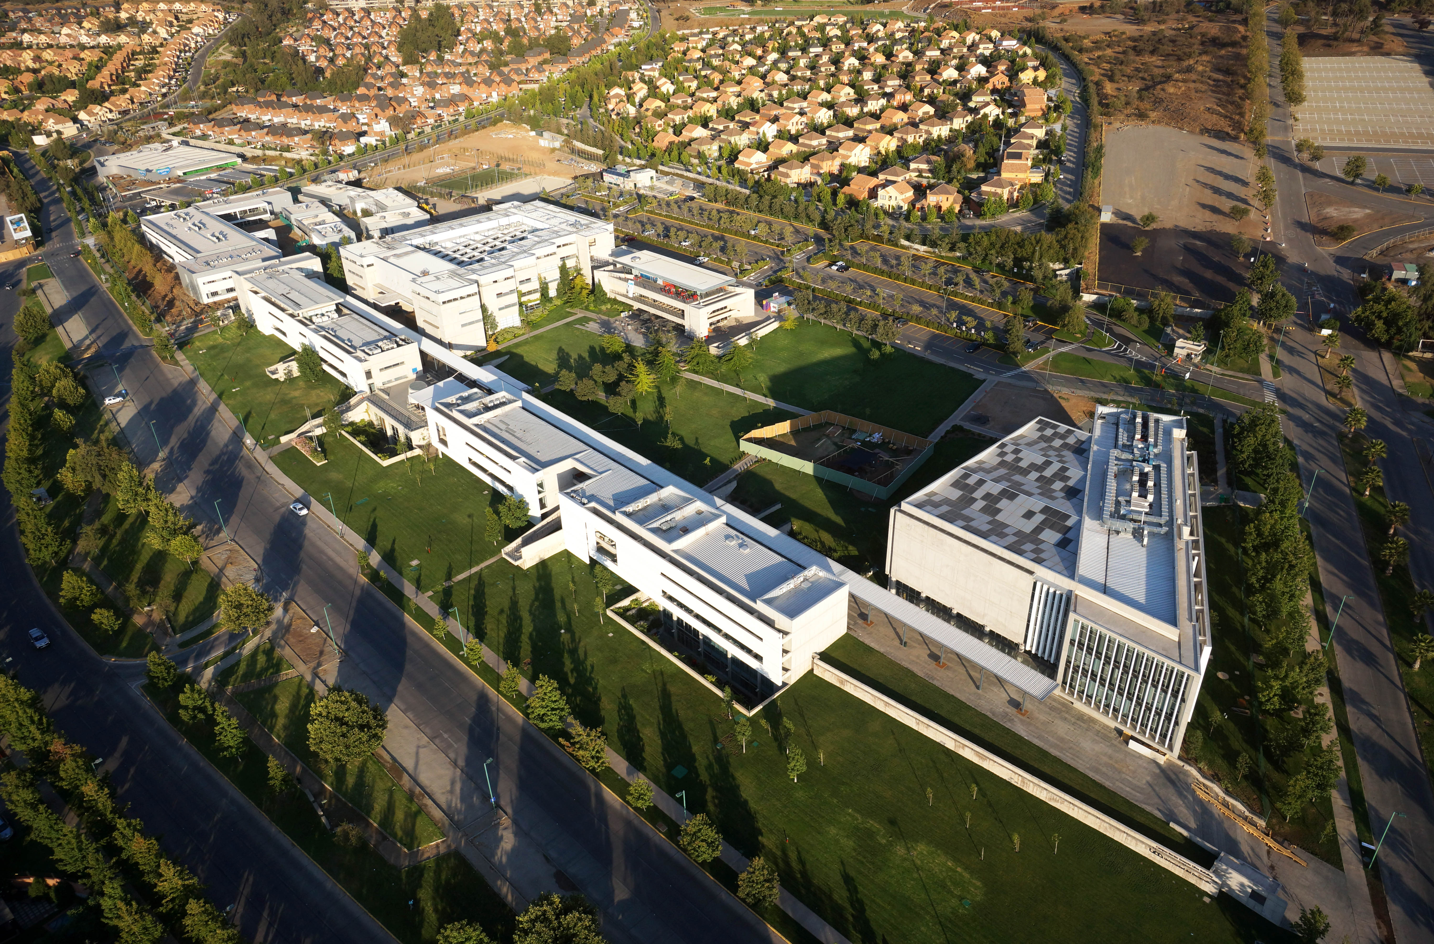


Slide 23
#UDDFuturo
Innovation & Entrepreneurship
Social Responsability
Interdisciplinarity
Globalization
UDD Experience

Slide 24
Founded 2012.
Design.
Engineering.
Business.
STVP
Stanford Technology Ventures Program

Slide 26
- Innovadores del Futuro (IDF).
- Minor in innovation.
- dLab.

Slide 28


Slide 29
Design
Engineering
Business
Advertising
Architecture

Slide 30
+
Theorical
Practical

Slide 31
Interdisciplinary
Teams
Close-knit unit
Skills and Know-How
17 teams
17 tutors

Slide 32
Investigation
Ideation
Prototyping
Implementation

Slide 33
Autodidact
Empathic
Curious
Other Interests

Slide 34



Slide 36
+
Innovation
Interdiscipline
Changemaker Agent

Slide 37
7 years.
16 students - 3 faculties.
Design Thinking.

Slide 38
ChileanThinking
- Rapid Prototyping.
- Entrepreunership.
- Commercialize Innovation.

Slide 39





473 alumni

Slide 40
Develop Skills
Start-ups

Slide 41



Slide 42
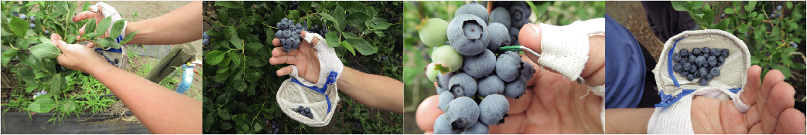
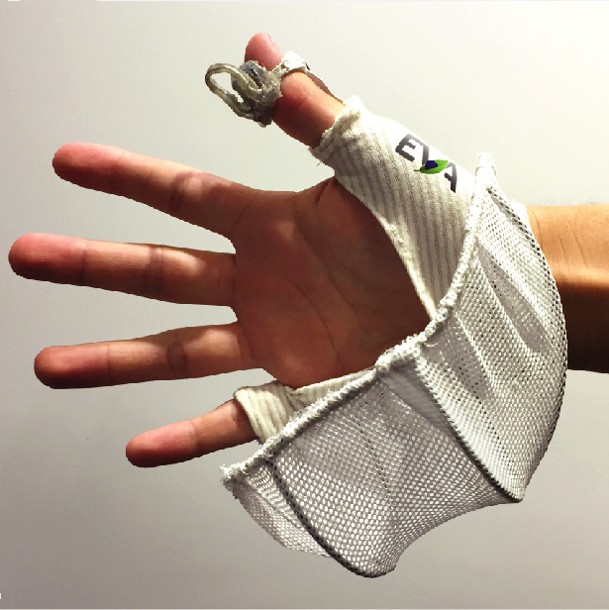
EVA

Slide 43
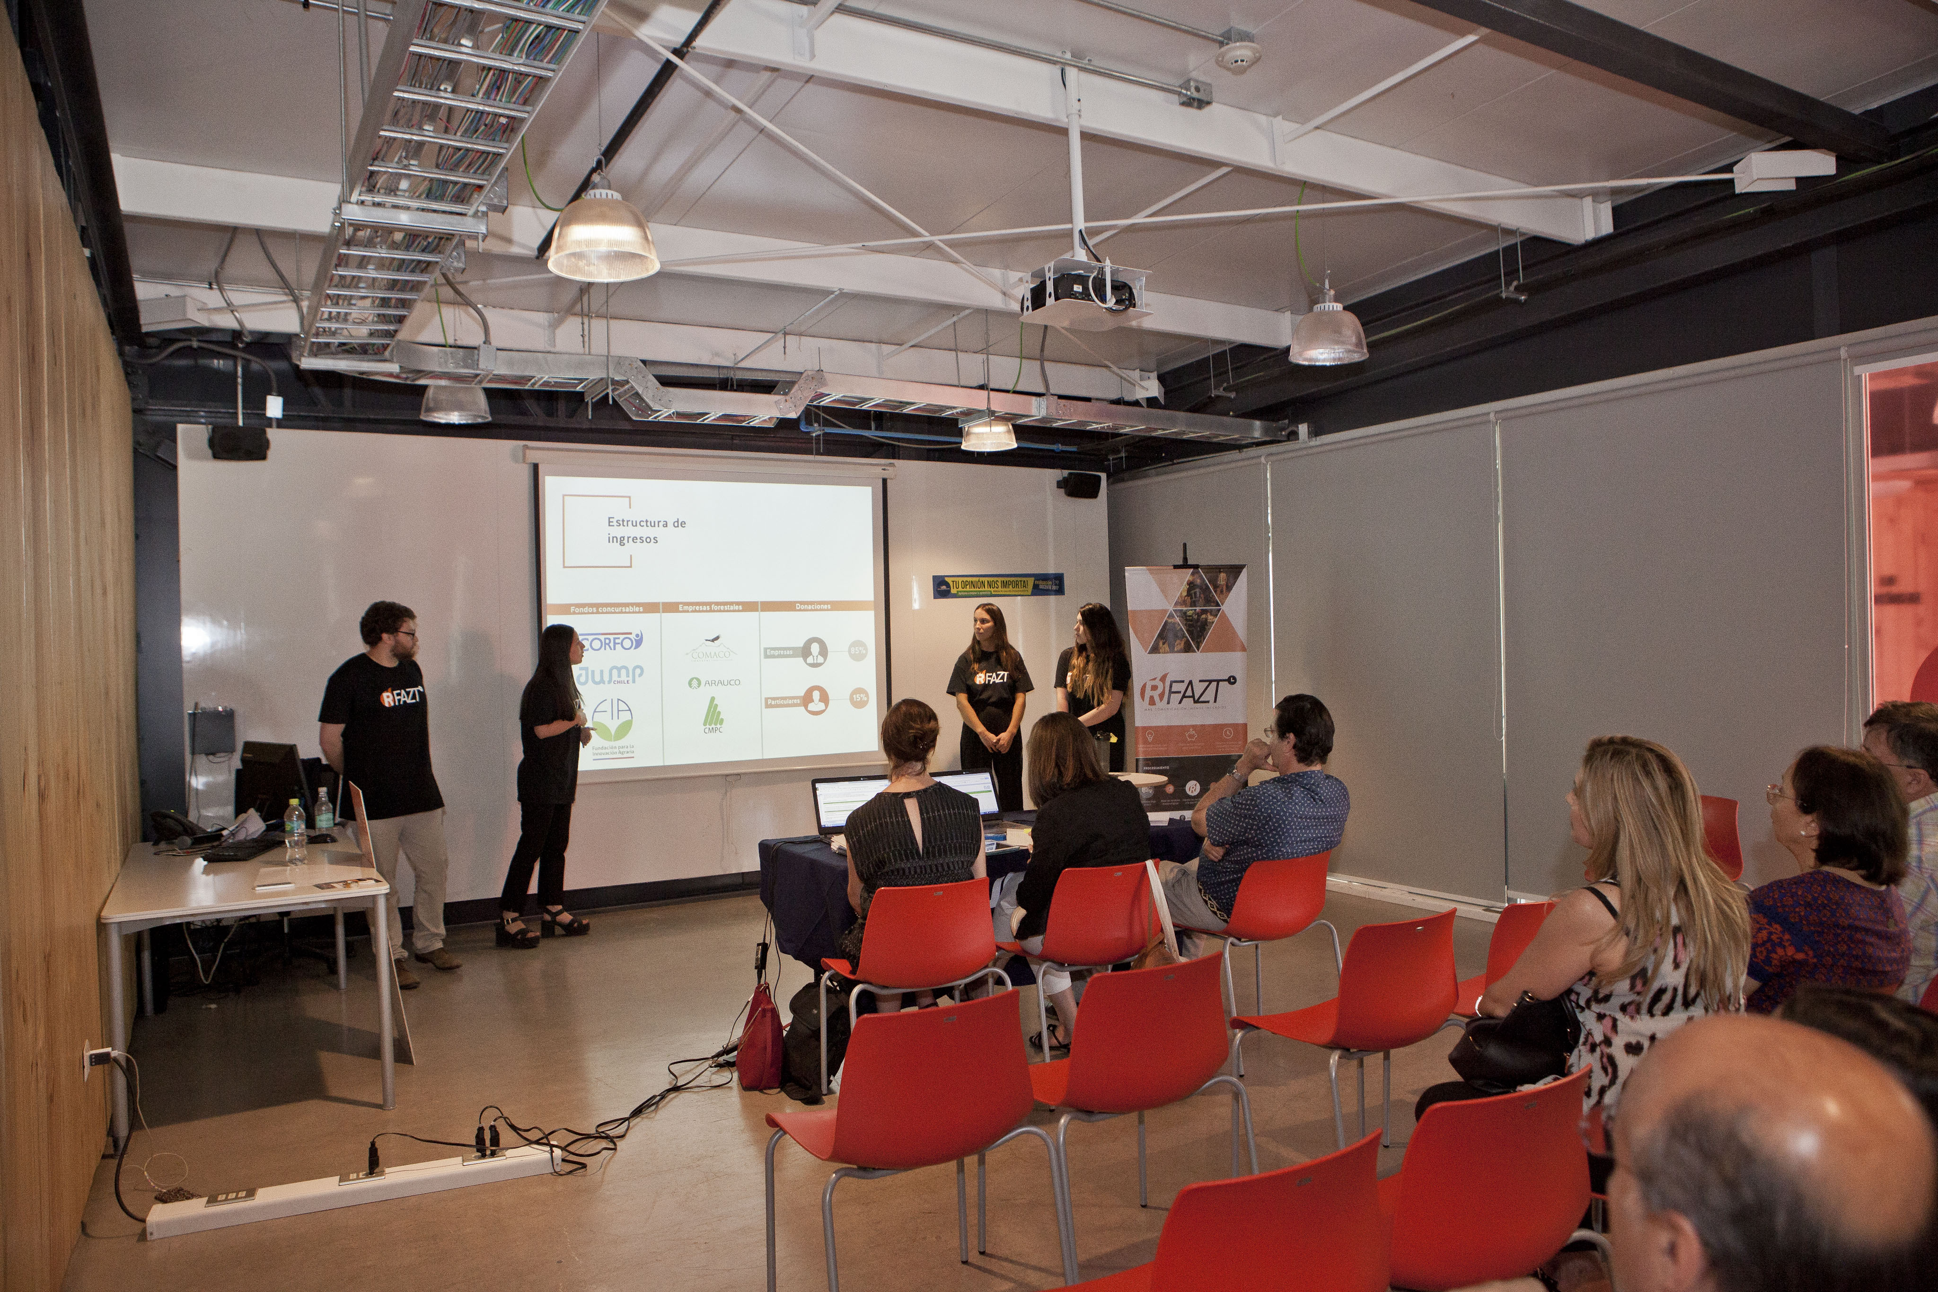
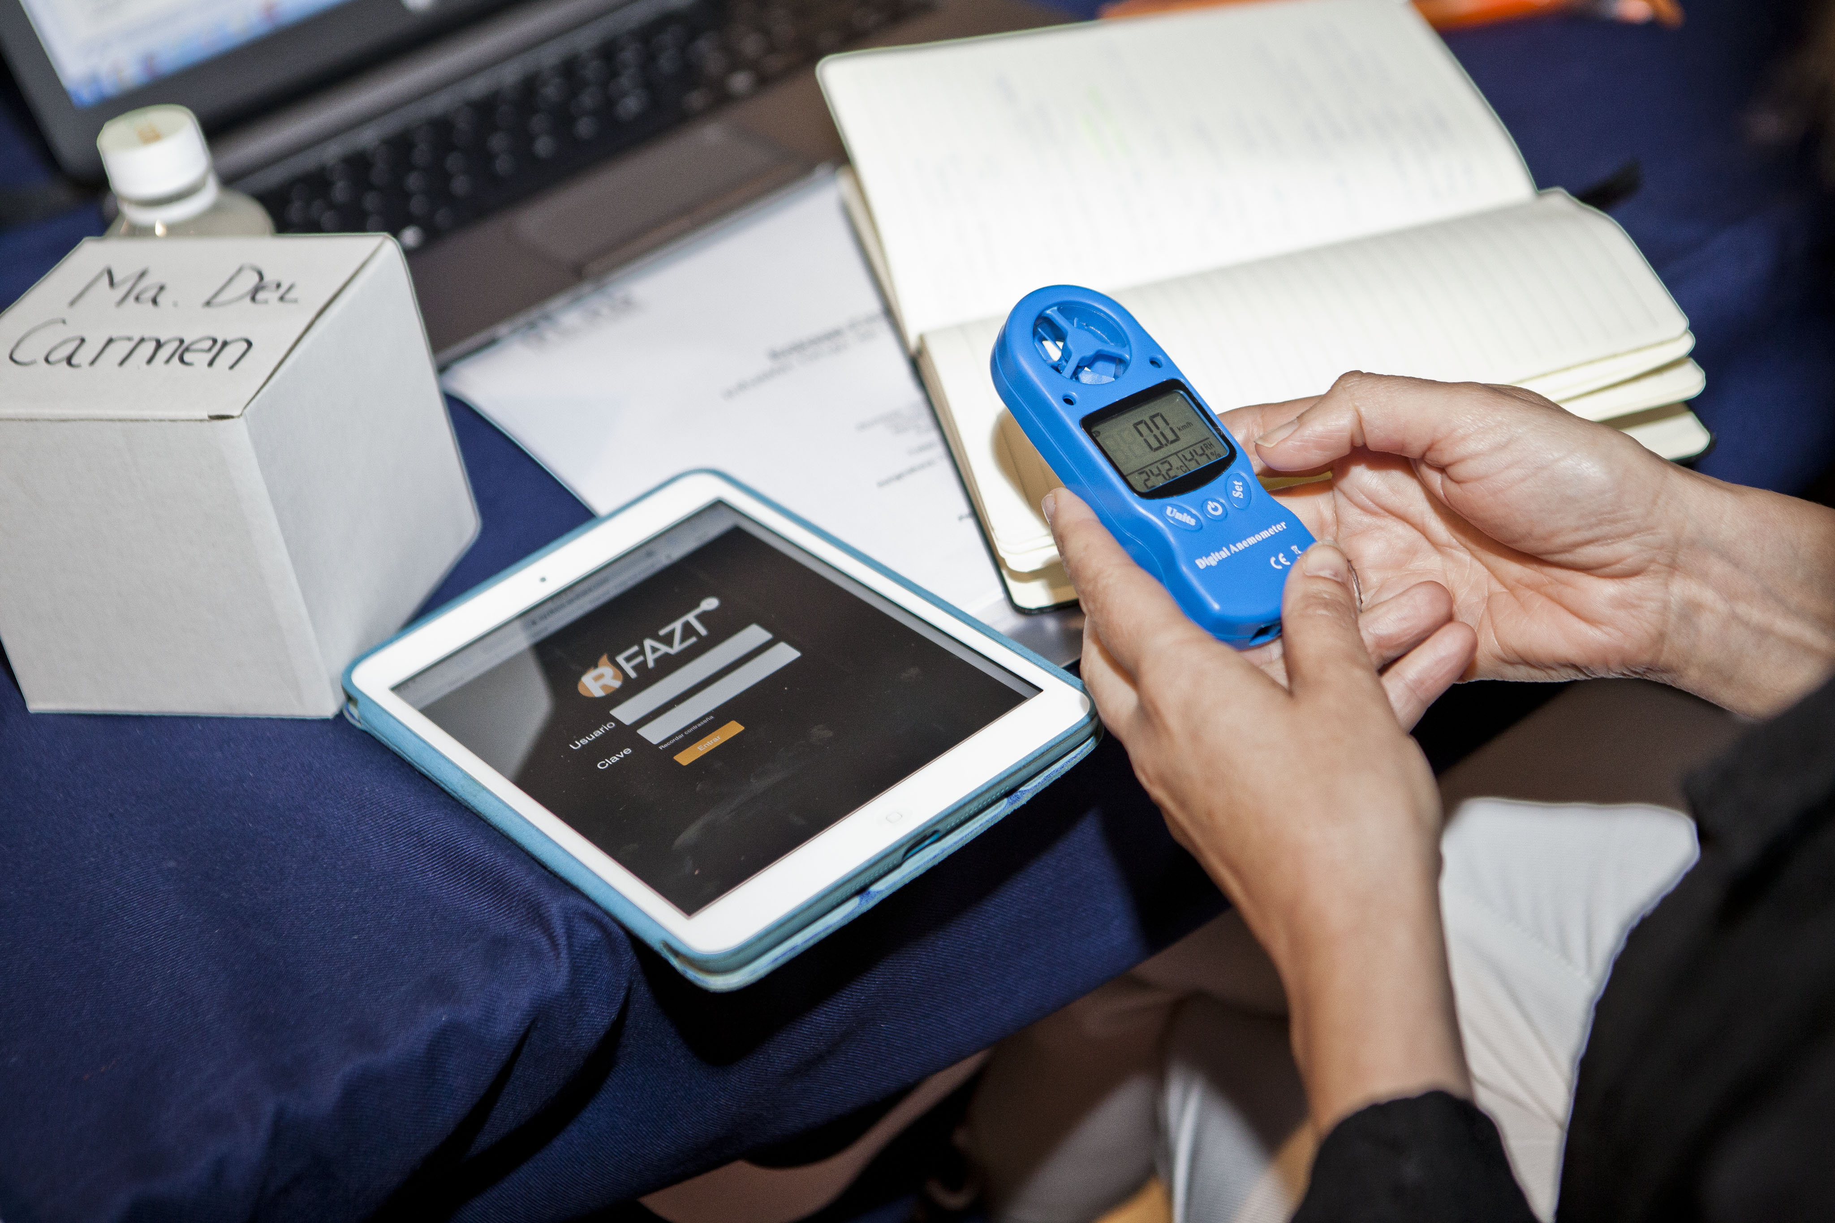

RFAZT

Slide 44



Slide 47
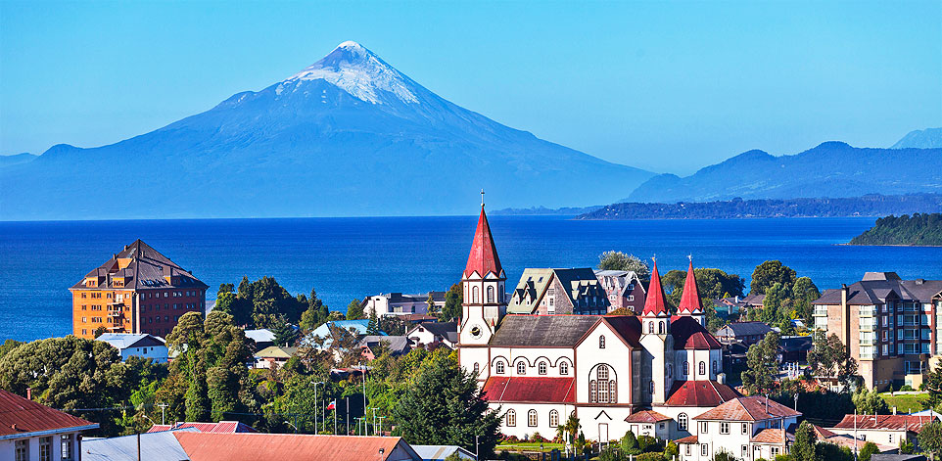

Slide 48
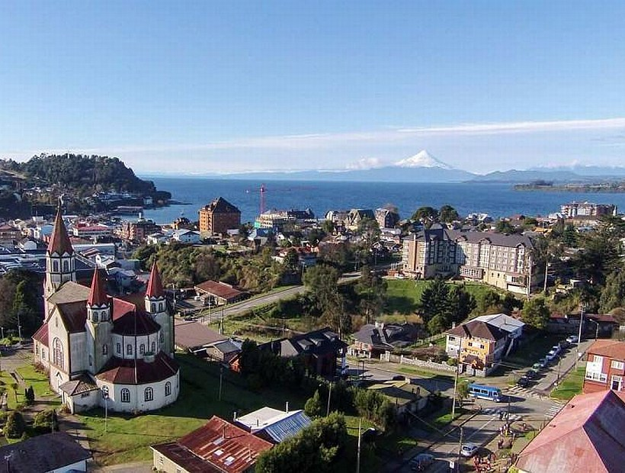

Slide 49
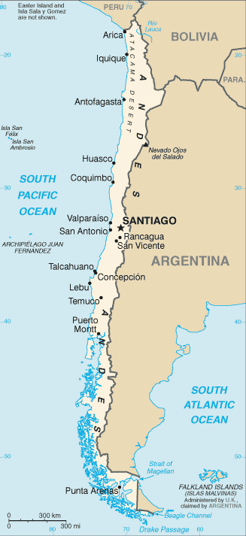

Slide 51
UDDFuturo
Innovation & Enterpreneurship
Social Responsability
Interdiscipline
Globalization
UDD Experience

Slide 52
Conflict resolution
Proactivity
Tolerance to frustation

Slide 53

